Slide 1
EXECUTIVE BENEFITS OVERVIEW
No bank or credit union guarantee | Not a deposit | Not FDIC/NCUA insured | May lose value | Not insured by any federal or state government agency
Notes:
We are going to spend some time thinking about Executive Benefits.

Slide 2
WHY EXECUTIVE BENEFITS?
PERSONAL LIFE
BUSINESS PERFORMANCE
ECONOMIC EFFICIENCY
Notes:
Why executive benefits?
For business owners, providing benefits to themselves and their key employees may help to improve their personal life. By creating golden handcuffs and incentive benefits, business performance may improve. And there may be economic efficiency, depending on the program selected.

Slide 3
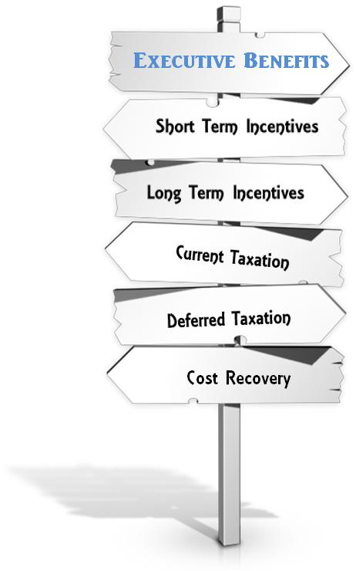
Elements of Executive Benefit Plans
Notes:
Benefits that are designed to reward the key people in your business (including yourself) come in many shapes and sizes.
The term “executive benefits” is an umbrella term for non qualified arrangements that are made between the business and certain executives.
These plans are not provided to all the employees in the business. The government tells us that these types of non-qualified arrangements may only be provided to the highly compensated or select group of management.
Interestingly, the benefits do not have to be offered to all of the key executives. You may pick and choose who will participate. And, the benefits may be different from participant to participant.
Depending on whether you are looking for short or long term incentives, want to provide benefits that result in deferred taxation, whether you want cost recovery to the business – the exact type of non-qualified benefit program that is most appropriate for you will vary depending upon your answers to these questions.

Slide 4
YOUR BUSINESS TIMELINE
YOUR BUSINESS TIMELINE
CURRENT BENEFIT PLANS
DEFERRED BENEFIT PLANS

Executive Bonus

Salary Continuation

Split Dollar – Loan Regime

Deferred Compensation

Split Dollar – Economic Benefit Regime
Notes:
A business has a life cycle and we measure that life cycle on the business time line. There are events that we know will occur. Often though, while the event itself is predictable when it will occur on your business time line is unpredictable.
One predictable event is the desire to provide a key person or persons with enhanced compensation and/or targeted benefits that are designed to reward and retain that employee. You may also, at some point on the timeline, want to provide benefits that help you attract special talent. And of course, using business funds to create a personal benefit for yourself and other owners may occur at any point on your business time line.
The cost and outlays of a plan will depend on some of the decisions you make now as well as the economic realities at the time the benefit is paid.
Benefit programs appear on a business time line in one of two ways.
Current benefit plans – where the business is making a current contribution and the participant is receiving a current benefit. The participant will either incur a current tax or other cost outlay (such as interest on a split dollar loan).
Deferred benefit plans – where the business is making a contractual promise to pay a benefit some time in the future. The participant generally does not receive a current economic value and so does not incur any current taxes or other cost outlays. The participant will include the benefits in income when actually received and the business will receive a tax deduction for those payments at that time.
There’s no one right or wrong answer for anyone. At times, using more than one program may create the right benefit to cost balance.

Slide 5
COMMON TYPES OF EXECUTIVE BENEFIT PLANS
EXECUTIVE BONUS
SELECTIVE INCENTIVE PLANS
BUSINESS
EXECUTIVE
BUSINESS
EXECUTIVE
BONUS THE PREMIUM
PROMISE TO PAY
SPLIT DOLLAR ECONOMIC BENEFIT
SPLIT DOLLAR LOAN
BUSINESS
EXECUTIVE
BUSINESS
EXECUTIVE
PREMIUM LOANED
DEATH BENEFIT ENDORSED
INTEREST
Notes:
I’ve illustrated four of the most common types of executive benefit plans. No detail now – I just wanted you to get a quick sense of how these arrangements operate.
A bonus plan involves a current bonus to the Executive. Often that bonus is used to pay the premium on a life insurance policy owned by the Executive.
A selective incentive plan is a deferred payout plan. The benefit is paid in the future, generally at retirement. There are many variations on the theme, but the key is that the benefit agreement is entered into today but the benefit is paid out and taxed at a later date.
Split dollar is a way to share the costs and benefits of a permanent life insurance policy. There are two split dollar methods, one is called split dollar economic benefit. The business will provide the executive with access to the death benefit portion of a permanent life insurance policy owned by the business. The executive acquires the death benefit protection at a fraction of the usual cost and the business continues to own and control the cash value funding the benefit.
The other is a split dollar program involves a loan arrangement. Here, the premium amount paid by the business is treated as a loan from the business to the executive and the executive will pay interest to the business on an annual basis. The executive acquires the benefits of the permanent life insurance policy at a fraction of the cost and the employer recovers the principal and interest on the arrangement.
As you can see, these are all very different plans. Which one, or which combination of arrangements is best suited to your case will depend on lots of variables. As we review the facts of your situation we will explore with you how these plans can help you achieve your executive benefit goals.

Slide 6
HOW EXECUTIVE BENEFITS WORK
Notes:
Let’s look at how executive benefits work.

Slide 7
BONUS PLANS
BUSINESS
EXECUTIVE
BONUS THE PREMIUM
Notes:
A bonus plan involves a current bonus to the Executive. Often that bonus is used to pay the premium on a life insurance policy owned by the Executive.
The bonus may be a deductible expense by the business. The executive will include the premium paid by the business in income. The executive’s out of pocket cost is the tax paid on the bonus.
The executive is the owner of the policy and will name the beneficiaries of the policy. The business should not, in any way, be a beneficiary of the policy.

Slide 8
SALARY CONTINUATION / DEFERRED COMPENSATION
BUSINESS
EXECUTIVE
PROMISE TO PAY
Policy loans and withdrawals reduce the policy’s cash value and death benefit and may result in a taxable event. Surrender charges may reduce the policy’s cash value early years.
Notes:
A selective incentive plan is a deferred payout plan. The benefit is paid in the future, generally at retirement. There are many variations on the theme, but the key is that the benefit is credited today but the benefit is paid out and taxed at a later date.
This arrangement must be in writing and provided to the highly compensated or select group of management. The terms will be spelled out and can vary greatly arrangement to arrangement. Generally, the business will informally fund the agreement by purchasing a life insurance policy on the life of the participant. The business may use the cash value of the policy by accessing them through policy loans and withdrawals as an informal source of funds to help defray the cost of the arrangement.

Slide 9
SPLIT DOLLAR ECONOMIC BENEFIT REGIME
BUSINESS
EXECUTIVE
DEATH BENEFIT ENDORSED
TAX ON TERM VALUE OF DEATH BENEFIT
Notes:
Let’s look at split dollar economic benefit. The business will provide the executive with access to the death benefit portion of a permanent life insurance policy owned by the business. The executive acquires the death benefit protection at a fraction of the usual cost and the business continues to own and control the cash value funding the benefit.
The business will be the owner of the policy and will control all elements of the policy. The business will endorse a portion of the death benefit to the executive who will name the beneficiary. The business will be the beneficiary of the remainder of the death benefit.
The employee will include in income the term insurance value of the death benefit payable to the executive’s beneficiary. The term rate maybe the IRS’s rates, known as the Table 2001 rates or the insurance company’s term insurance rates.

Slide 10
SPLIT DOLLAR LOAN REGIME
BUSINESS
EXECUTIVE
PREMIUM LOANED
INTEREST
Notes:
The other is a split dollar loan arrangement. Here, the premium amount paid by the business is treated as a loan from the business to the executive and the executive will pay interest to the business on an annual basis. The executive acquires the benefits of the permanent life insurance policy at a fraction of the cost and the employer recovers the principal and costs of the arrangement.
The agreement should be in writing. The executive will pay interest on the loan to the business. The business will include that interest payment in income. The executive will own the policy and a collateral assignment will be used to secure the business’ interest in the policy. That interest is equal to the total premium loans it has made. At the termination of the arrangement the employee will repay the loan, usually by either taking policy loans, or surrendering some of the cash value of the policy and the collateral assignment will be released. The employee will control all remaining policy values in excess of the business’ interest in the policy.

Slide 11
What Motivates Your Decision
Protection and Potential for Personal Accumulation
Key Person Retention
?
Taking Care
Of the Family
Business Needs
Tax Concerns
Cash Flow
Notes:
Let’s consider the basic questions that might motivate your decision when it comes to entering into an executive benefit arrangement.
Your starting point is your personal and family needs – are you looking for the potential for personal accumulation and a tool to help protect your family against the loss of your income.
Are you looking for key person retention.
What are your other business needs. How is your business and personal cash flow.
Last but not lease - what are your tax concerns.
I know these are a lot of questions to ask – but they are elemental in helping you to design and executive benefit program for you and your business.

Slide 12
Next Steps

Consider Your Business Situation

Consider Your Personal Situation

Identify the Key Issues

Review and Discuss With Your Planning Team
Notes:
Here are the next steps in the process.

